Slide 1


Hotel Management system

Slide 2
Team members
Love Dubey
2100290140083
Sec - c
Chirag sharma
2100290140055
Sec - c
Vivek singh
2100290140153
Sec - c
Supervisor: Ms. Komal Salgotra
Assistant Teacher
KIET GROUP OF INSTITUTION

Slide 3
introduction
Hotel management system is a website where the management of entire hotel is computerized. The hotel management system is designed using html,css and javascript as the rich GUI for front end and php,mysql server as the secured backend database.
In this project the details are maintained like customer details, reservation details, booking details and billing details the reservation process of reserving rooms for the customers, cancelling the reserved rooms, booking the rooms, vacating the rooms, the restaurant management, billing process, etc all are computerized and the management is done without any difficulty.

Slide 4
Objective
In this website hotel bookings and rooms make this system very flexible and convenient. The hotel manager is a very busy person and does not have the time to sit and manage the entire activities manually on paper.
This website gives him the power and flexibility to manage the entire system from a single online system. Customers can view and book room online. Admin has the power of either approving or disapproving the customer’s booking request.
Hotel services can also be viewed by the customers and can book them too.

Slide 5
Functional requirement
Reservation module: during reservation, the details of the customers, type of room required and number of room required are fed in to the system.
Room booking module: in this module, the admin gives confirmation for the room which is booked by the user.
Room status module: in this module, the admin can see the number of rooms which are reserved and which are not reserved.
Generate reports: this module deals with the generation of the reports for the various modules. The customer list can be generated. Room status list can be retrieved for reference.

Slide 6
Non functional requirements
Security: security requirements ensures that the system is protected from unauthorized access to the system and store data.
Reliability: Reliability defines how likely it is for the software work without failure for a given period of time.
Performance: performance is quality attribute that describes the responsiveness of the system.
USABILITY: Usability defines how difficult it will be for user to learn and operate the system.

Slide 7
Hardware & Software requirement
Processor: Multi-core – 1.8 GHz processor or better.
Ram: 4GB RAM.
Hard disk: 80GB.
Operating system: Windows 7, 8 and above.
Front END: Html, css, javascript.
Back end: php, mysql.

Slide 8
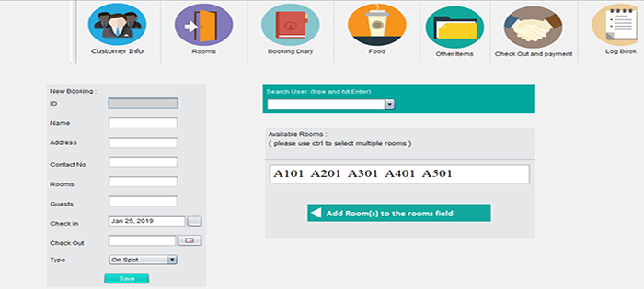

Slide 9
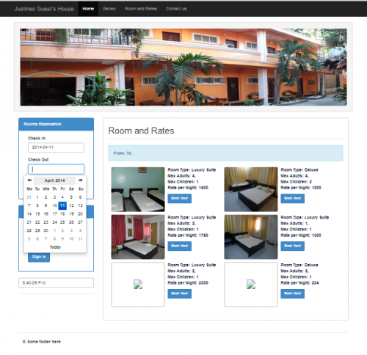

Slide 10
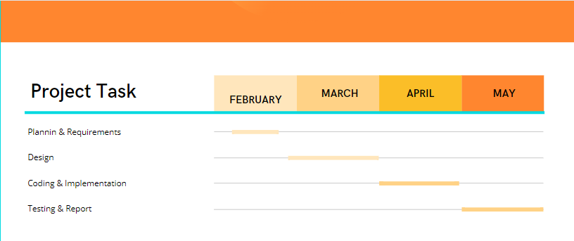
March
April
May
June

Slide 11
references
https://www.lovelycoding.org/hotel-management-system/
https://www.google.com/url?sa=i&url=https%3A%2F%2Fcode-projects.org%2Fhotel-management-system-in-java-with-source-code%2F&psig=AOvVaw16bFrYzssuCBR0skSZkbUs&ust=1646896629693000&source=images&cd=vfe&ved=0CAsQjRxqFwoTCNCp25q-uPYCFQAAAAAdAAAAABAD
https://www.google.com/url?sa=i&url=https%3A%2F%2Fwww.vetbossel.in%2Fhotel-management-system-php%2F&psig=AOvVaw16bFrYzssuCBR0skSZkbUs&ust=1646896629693000&source=images&cd=vfe&ved=0CAsQjRxqFwoTCNCp25q-uPYCFQAAAAAdAAAAABAY

Slide 12


